Slide 1


Slide 2


Why Breastfeeding Training
Pivotal time in WIC to support breastfeeding families.
WIC food packages
Importance of exclusive breastfeeding
Standardized training
Competency-based approach
Skills-building

Slide 3
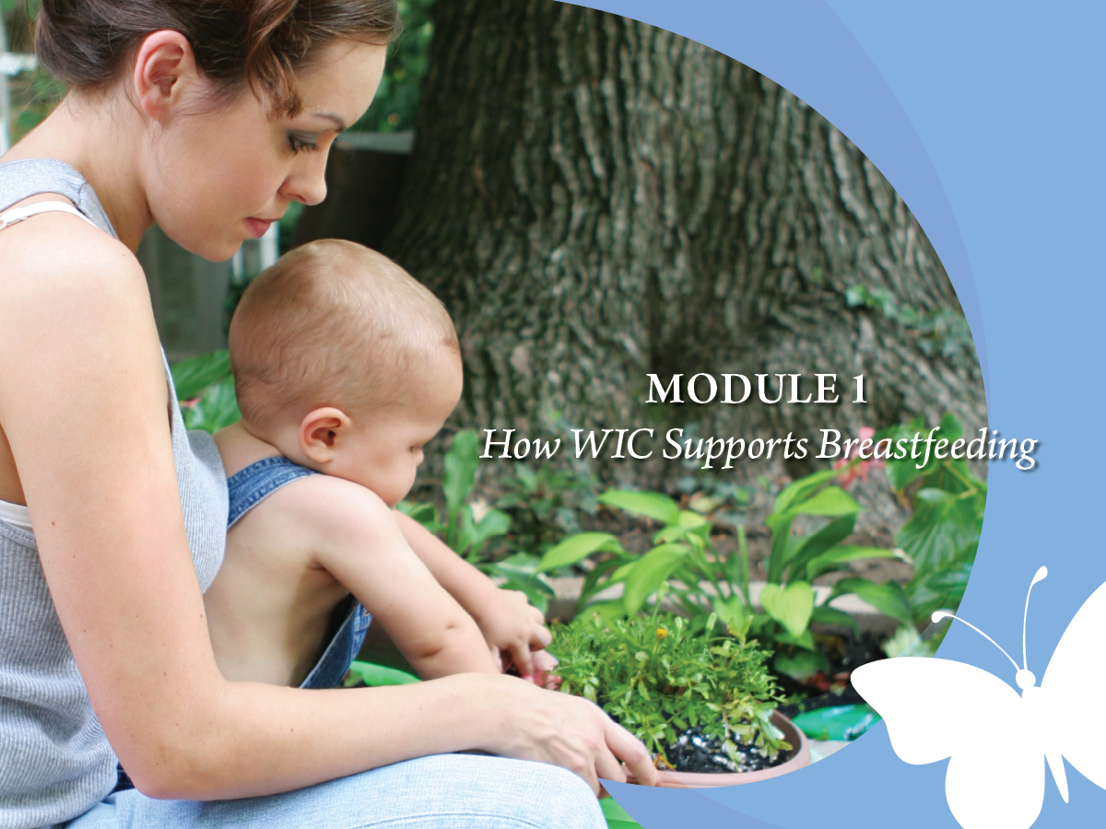

Slide 4
Core Competencies
Promotes and supports breastfeeding in a manner that is consistent with WIC regulations, policies, and initiatives.
Discusses with mothers and their families how WIC promotes and supports breastfeeding.
Handout 1.1: “Breastfeeding Core Competencies for All WIC Staff”

Slide 5
Learning Objectives
Identify how breastfeeding benefits infants and mothers.
Recognize personal role and responsibilities as part of the WIC “team” that promotes, protects, and supports breastfeeding.
List the ways the WIC Program supports breastfeeding families.
Explain how the WIC food packages support the breastfeeding mother and infant.

Slide 6
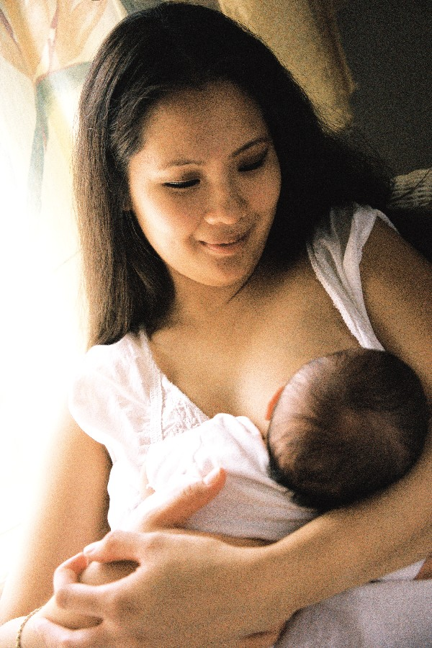
Breastfeeding is a Priority in the WIC Program
WIC’s goal: safeguard health of women, infants, and children
WIC’s focus: help mothers make informed choices
Breastfeeding promotion and support has grown

Slide 7


What Does WIC Mean to You?
Hialeah West WIC, Miami, FL

Slide 8

Why WIC Supports Breastfeeding
North Miami, FL WIC

Slide 9

Definitions of Breastfeeding and Exclusive Breastfeeding
Breastfeeding: the practice of feeding a mother’s breast milk to her infant(s) on the average of at least once per day
Exclusive Breastfeeding: the infant receives only breast milk and nothing else

Slide 10
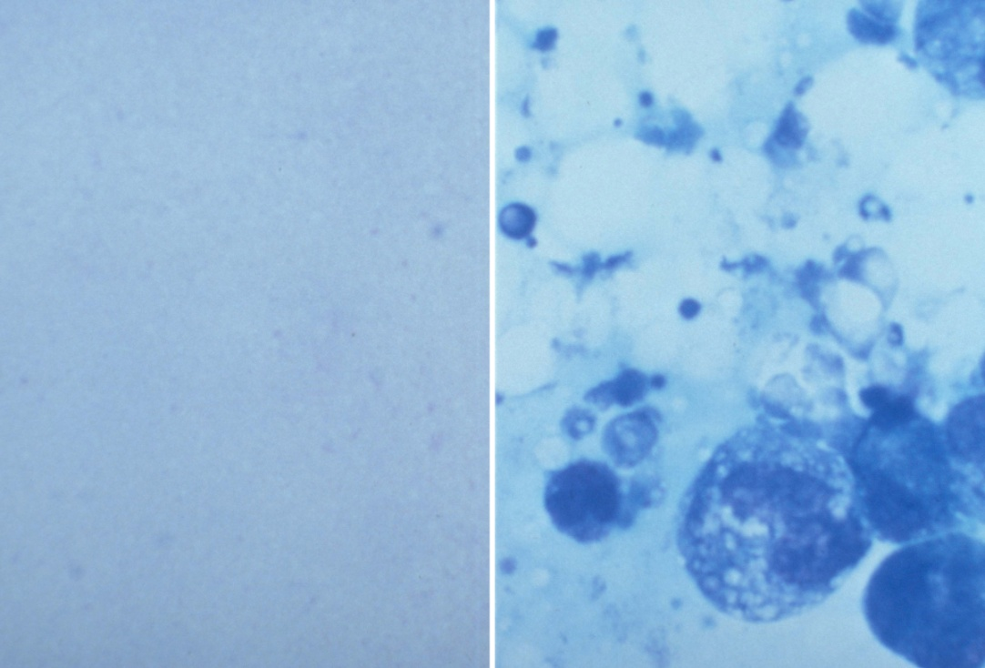
Breast Milk: The Standard by Which Everything Else is Measured

Slide 11
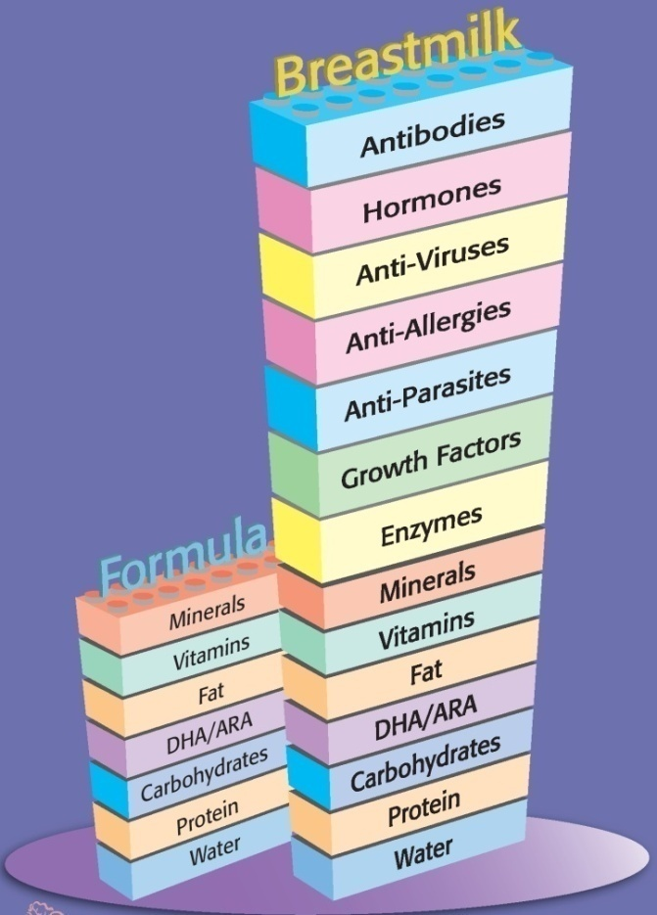
Breast Milk: The Standard by Which Everything Else is Measured
Breast Milk has:
Vitamins and minerals for proper nutrition
Growth factors that help with infant growth and development
Antibodies that help babies resist illness and disease
The ability to change constantly

Slide 12

Breast Milk: Custom Made for Baby

Slide 13


Breastfeeding: Growing Healthy Babies and Moms

Slide 14
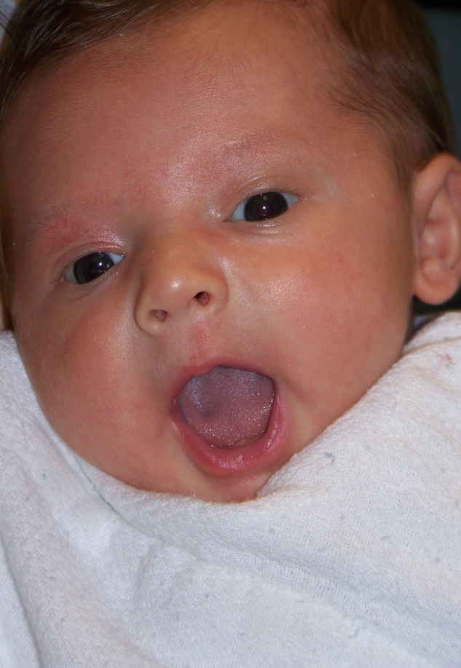
Babies Grow and Glow With Breastmilk
Breastfeeding reduces baby’s risk of:
Obesity
Ear infections
Respiratory infections
Gastrointestinal infections
Skin conditions
Type 1 and Type 2 diabetes
Leukemia
Sudden Infant Death Syndrome
West Dade WIC

Slide 15
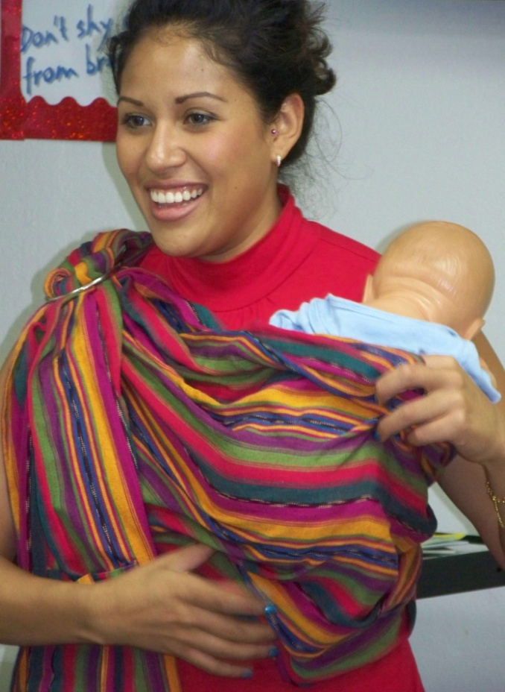
Breastfeeding Is Also Good for Mothers
Lowers risk of:
Premenopausal breast cancer
Ovarian cancer
Type 2 diabetes
Improves bonding
Lowers healthcare costs
Convenient
Hialeah WIC, Miami, FL

Slide 16

Increasing Breastfeeding Rates: A National Health Objective
Centers for Disease Control and Prevention, National Immunization Registry, 2006

Slide 17

An Opportunity to Make a Difference

Slide 18

Loving Support Makes Breastfeeding Work

Slide 19


Loving Support Materials

Slide 20

Expanding Our Garden: Building upon Loving Support
Peer Counseling training curriculum
Resources to facilitate community partnerships
Educational materials targeting Hispanic families and African American fathers
Using Loving Support to Grow and Glow in WIC

Slide 21
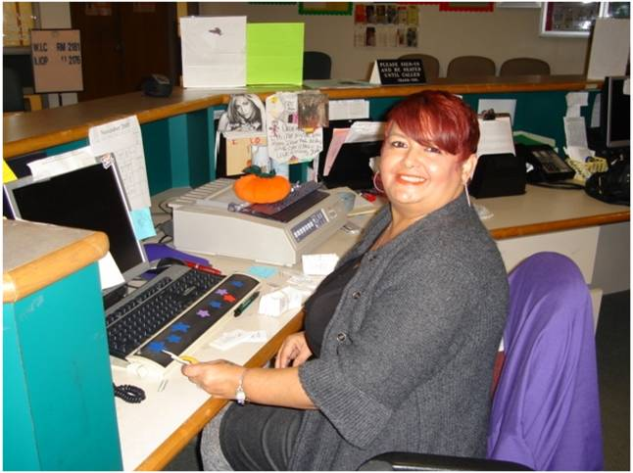
How WIC Helps
Hartford, CT WIC

Slide 22

Using New Eyes

Slide 23

A New Look at the WIC Food Packages
Institute of Medicine recommendations:
Increase dollar value and attractiveness
Address differences in nutrition needs
Minimize the amount of formula to breastfed infants

Slide 24
Value Added Food Packages for Breastfeeding Moms
Greater quantity and variety of foods to breastfeeding moms and babies
Support exclusive breastfeeding
Protect mother’s milk production
Handout 1.2: “WIC Food Packages for Breastfeeding Mothers and Babies”

Slide 25
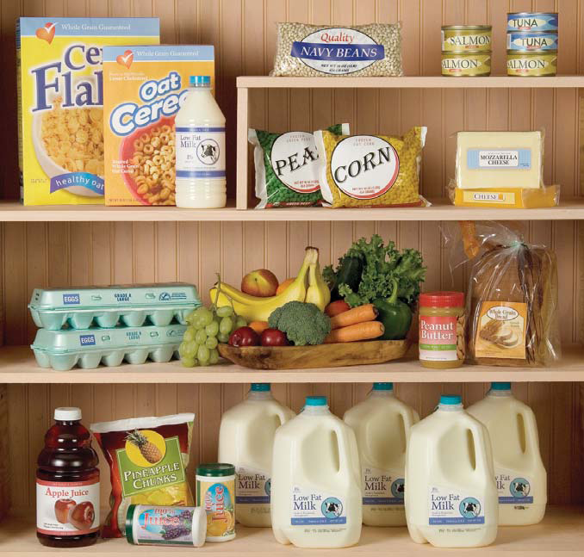
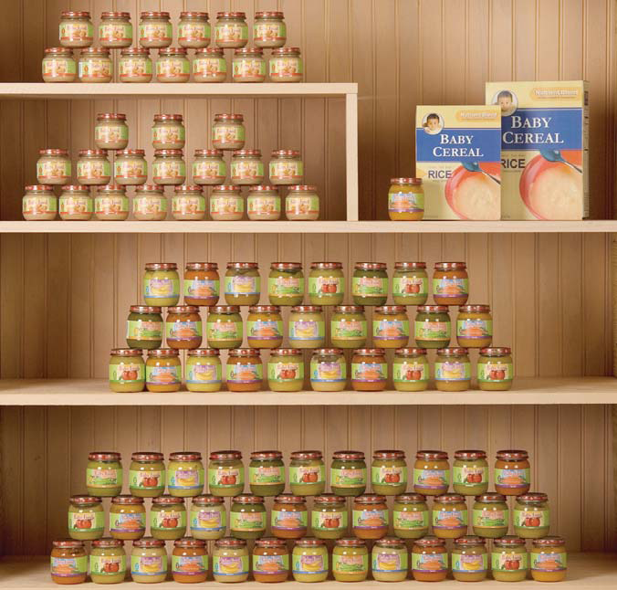
Fully Breastfeeding Food Package
“Grand Deluxe Package”
Fully Breastfeeding Mom – up to 12 months
Infant 6-11 months
Photos Courtesy of Texas WIC State Agency

Slide 26
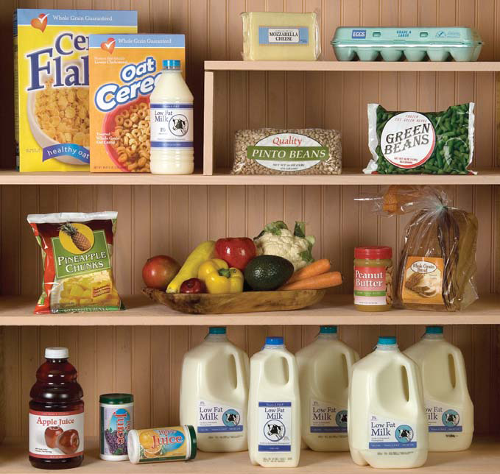

Partially Breastfeeding Food Package
“Deluxe Package”
Partially Breastfeeding Mom – up to 12 months
Infant 6-11 months
Photos Courtesy of Texas WIC State Agency

Slide 27
Application to Practice
Story Starter:
A pregnant woman is thinking about
breastfeeding, but feels she will probably
want to give formula too. She did this with
her last baby. She asks about the
breastfeeding support services that WIC
Provides and how WIC can help her.

Slide 28

Why We Minimize Formula Amounts for Breastfeeding Babies
Formula decreases milk production
WIC provides:
Breastfeeding education
Support
Referrals

Slide 29
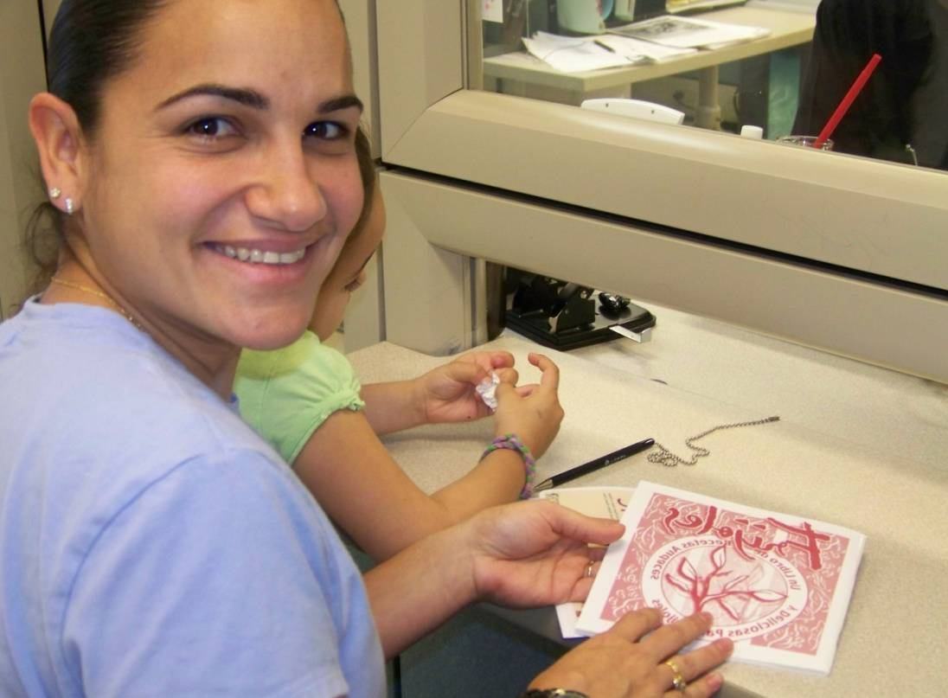
Will Breastfeeding Mothers Ask for the Full Formula Package?
West Dade, FL WIC

Slide 30
Your WIC Breastfeeding Team: a WIC Mother’s “Circle of Care”

Slide 31
Local Agency Clerks
Sets the tone with breastfeeding-friendly language
Refers mothers for support and follow-up
First responder to questions
Hartford, CT WIC

Slide 32

Competent Professional Authority (CPA)
Conducts a complete WIC breastfeeding assessment
Provides education, assistance, and referrals
Prescribes appropriate food packages
Hialeah WIC - Miami, Fl

Slide 33

Coordinator/Manager
Encourages and supports breastfeeding promotion activities and training
Allocates funding and resources for breastfeeding promotion and support
Unity Health Care WIC, Washington, D.C.

Slide 34

Local Agency Peer Counselor
Role model for breastfeeding
Gives mother-to-mother support outside usual WIC clinic hours and environment

Slide 35
Breastfeeding Coordinator
Coordinates breastfeeding activities
Oversees planning, implementation, evaluation, training, and community collaborations

Slide 36
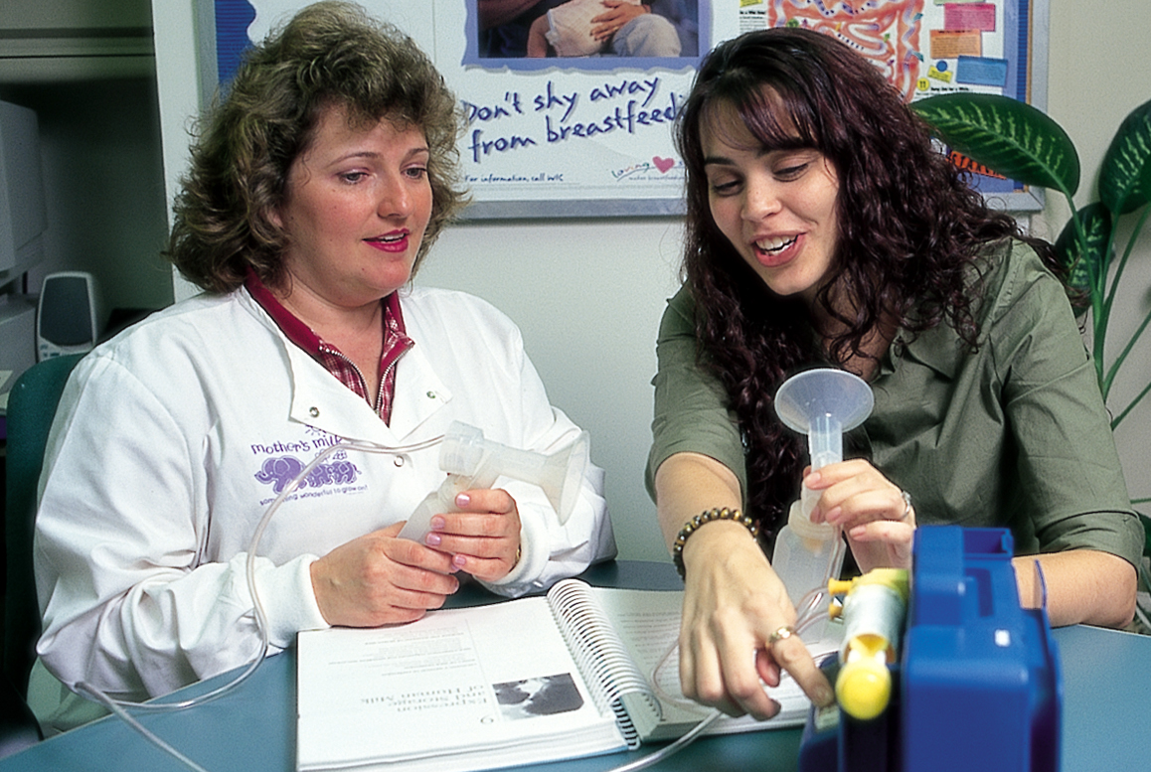
The WIC Designated Breastfeeding Expert

Slide 37

Breastfeeding Welcome Here!
Handout 1.3: “Is Your Clinic Breastfeeding Friendly?”

Slide 38
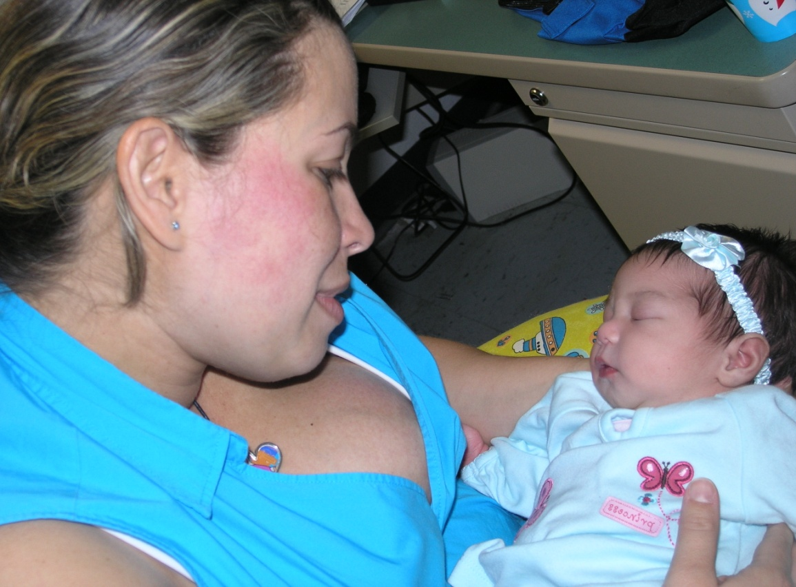

Through the Eyes of WIC Mothers
Hialeah WIC – Miami, FL

Slide 39
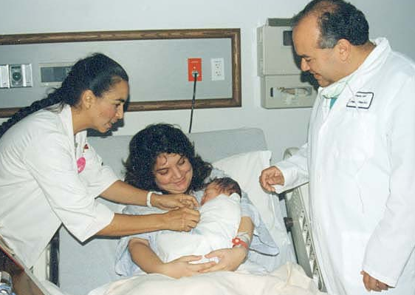
Using Loving Support to Build a Breastfeeding-Friendly Community
Texas WIC

Slide 40
Creating a Framework of Loving Support

Slide 41
Summary
How and why WIC promotes and supports breastfeeding
Every person plays an important role as part of the WIC breastfeeding team
Together we can improve the health of millions of mothers and babies

Slide 42

Grow Your Breastfeeding Skills
“My Goals for Breastfeeding Support”
Goal-Setting Flower

